Slide 1
Restaurant Analysis and Visualization Using Power BI
By Srivardhini R
Batch: MBE8

Slide 2
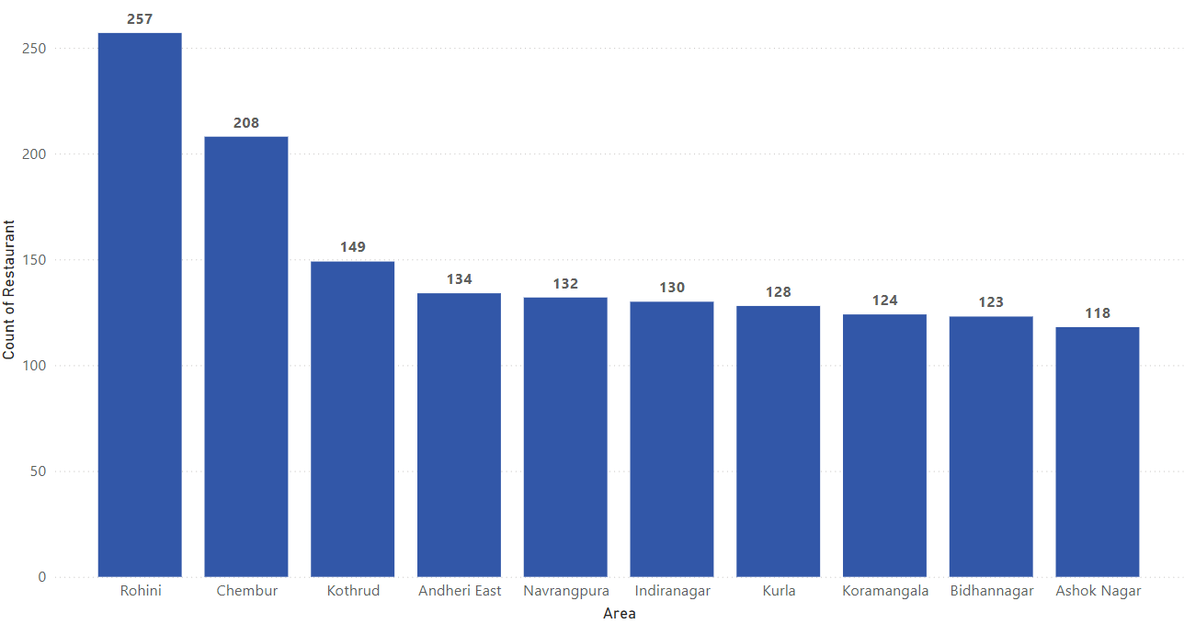
Top 10 Areas with Most Restaurants
Findings
At 257, Rohini had the highest Count of Restaurant and was 117.80% higher than Ashok Nagar, which had the lowest Count of Restaurant at 118.
Across all 10 Area, Count of Restaurant ranged from 118 to 257.
Out of these top areas, 5 areas serve chinese the most.

Slide 3
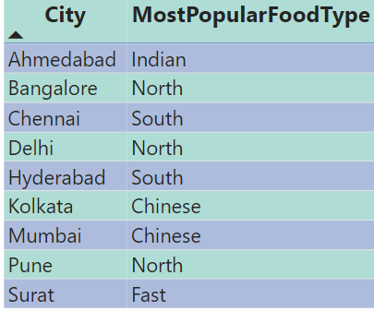
Most Popular Food Types served by swiggy restaurants in Each City
Findings
Most popular food type across all cities is north.
23% of pune restaurants serve north and 11.4% of chennai restaurants serve south.
Most of cities prefer traditional food rather than foreign food type.

Slide 4
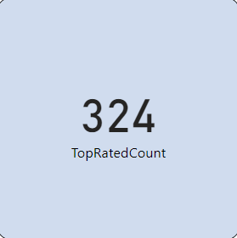
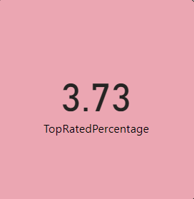
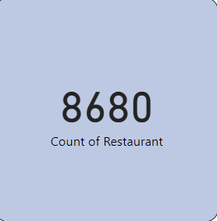
Top Rated Swiggy Restaurants (In Percentage)
Findings
Among 8680 restaurants, 3.73% of restaurants are top rated with ratings above 4.5
Chennai and kolkata have highest top rated restaurants
Delhi and surat have lowest top rated restaurant.

Slide 5
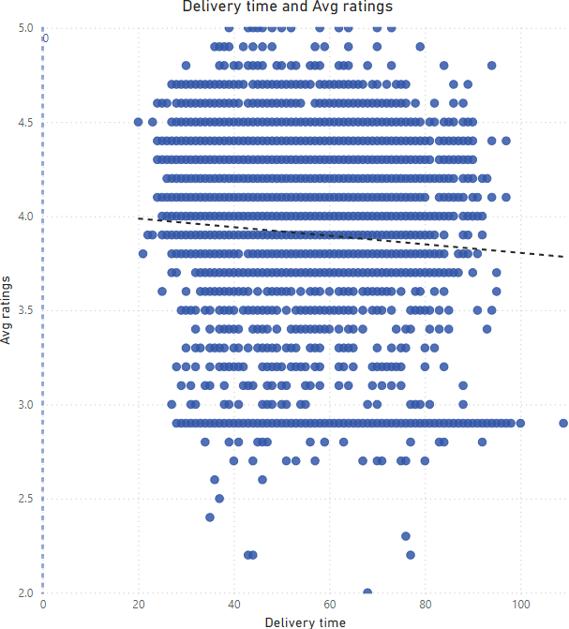
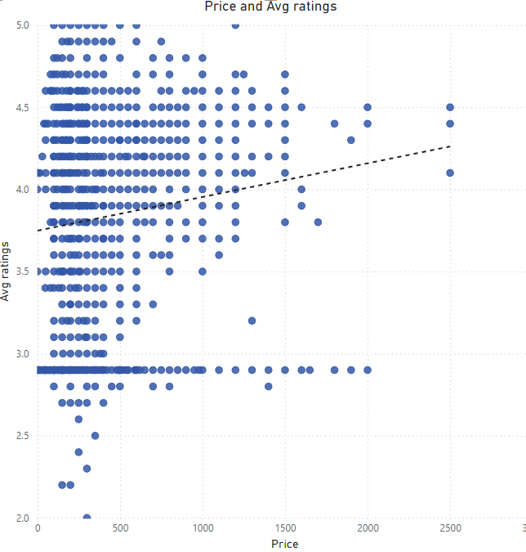
Correlation of Factors Affecting Average Rating
Findings
In delivery time and avg rating analysis, the trend line negative correlation, suggests that faster delivery times are associated with higher customer satisfaction and ratings
In price and avg rating analysis, the trend line shows a positive correlation, suggests that higher-priced restaurants tend to have higher average ratings.

Slide 6
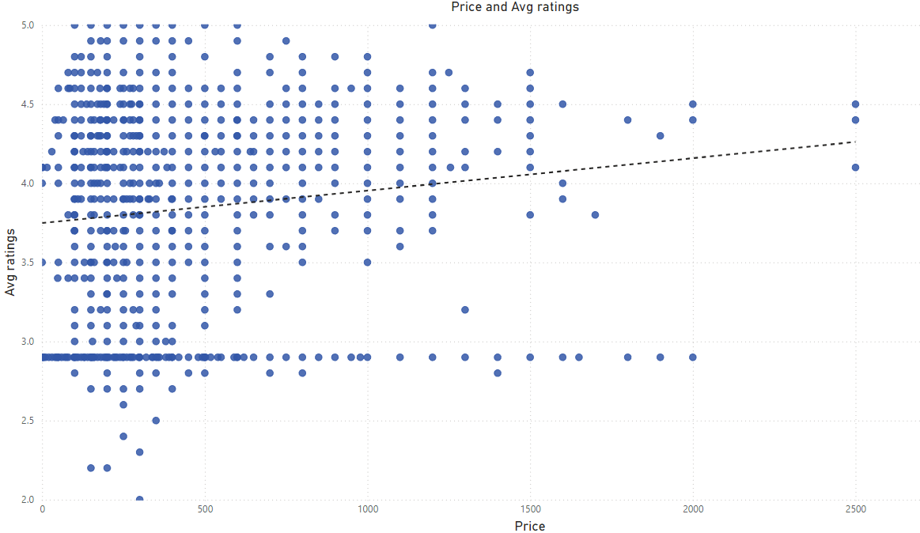
Correlation Between Restaurant Price and Average Rating
Findings
The analysis shows a positive correlation between price and average rating, suggesting that higher-priced restaurants tend to receive better reviews.
This indicates that customers might associate higher prices with better quality or service.

Slide 7
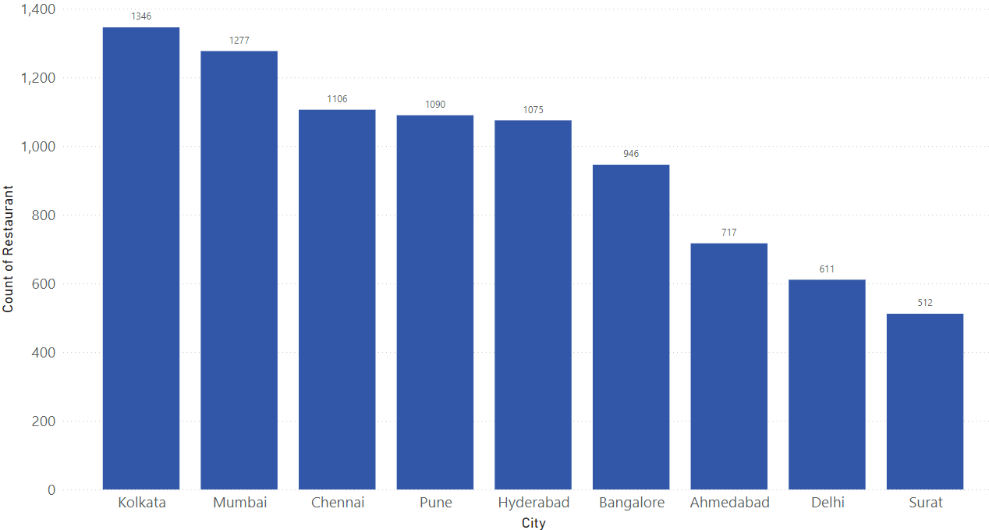
City-wise Restaurant Count
Findings
At 1,346, Kolkata had the highest Count of Restaurant and was 162.89% higher than Surat, which had the lowest Count of Restaurant at 512.﻿
Kolkata has 61 top rated restaurants, compared to surat’s 14.
Chennai has highest average ratings with 3.78 while delhi has lowest with 3.53

Slide 8
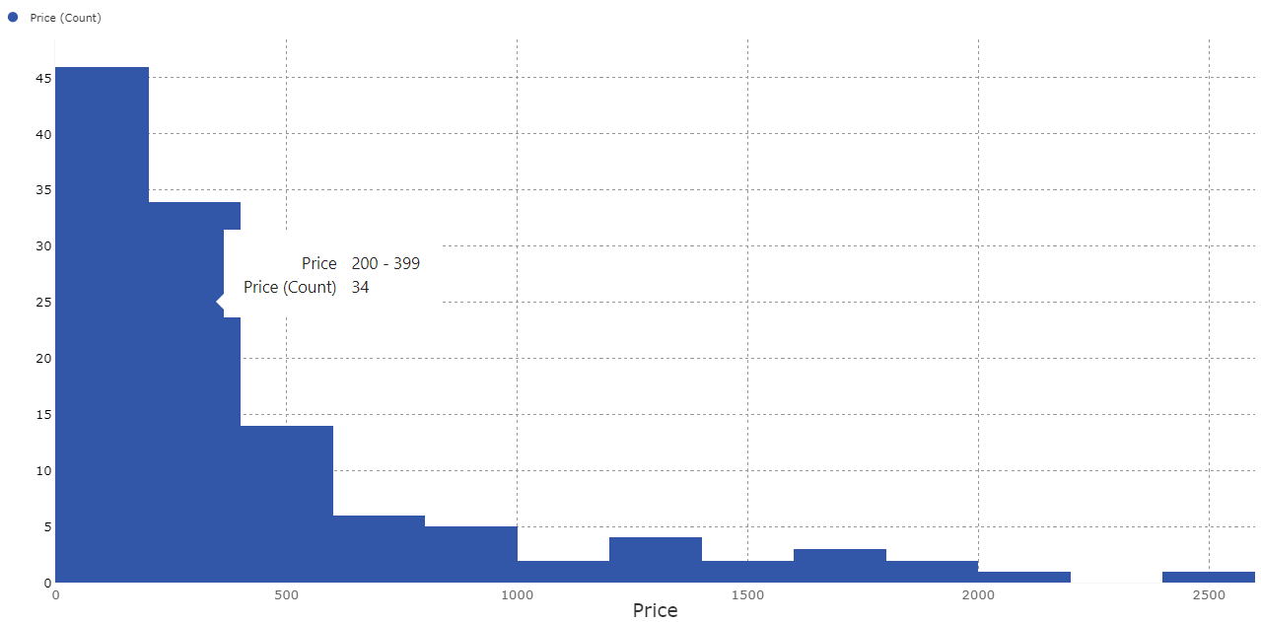
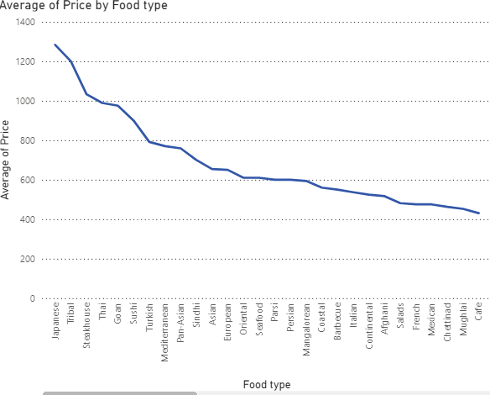
Price Analysis
Findings
The average ratings increases with price.
Expensive food types are most likely to be foreign food type. The most expensive food is japanese
Only a few restaurants have prices above 1000, while the most common food types are the cheapest.

Slide 9
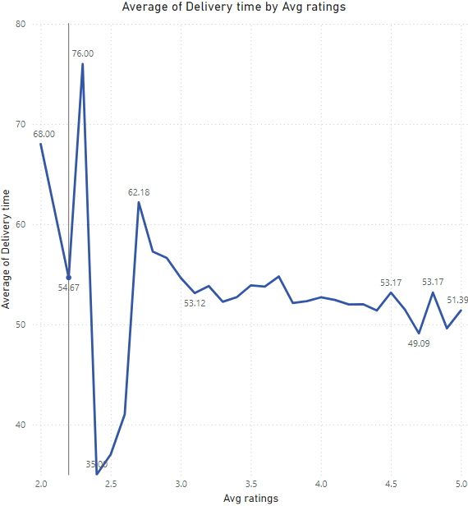
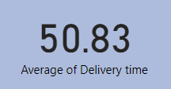
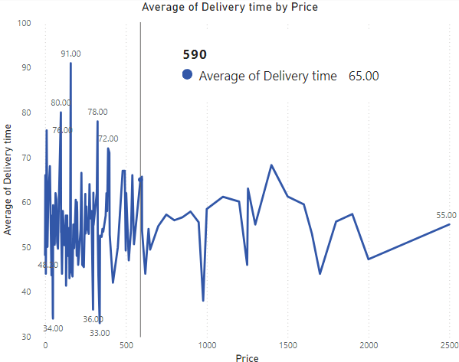
Delivery Time Analysis
Findings
50.83 is average of delivery time of top rated restaurants
The price increases as the delivery time decreases
The average ratings increases as the delivery time decreases

Slide 10
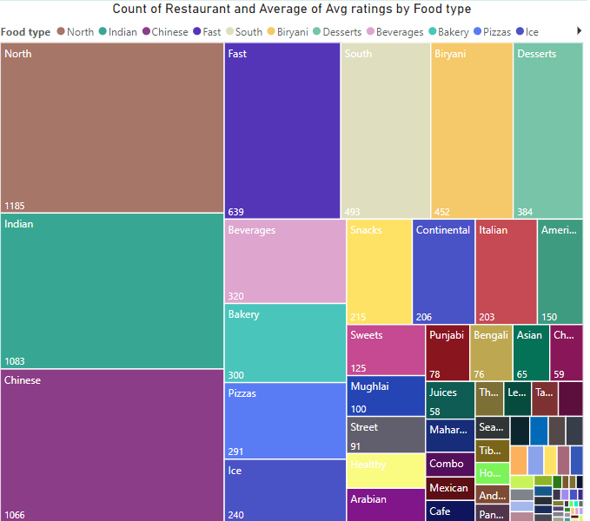
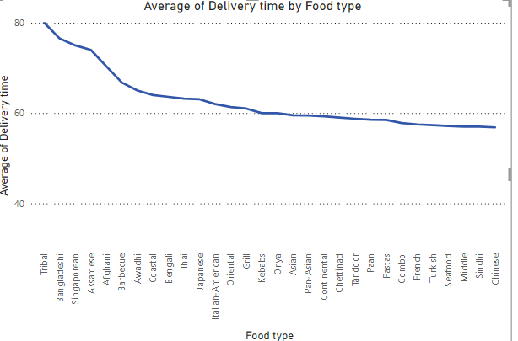
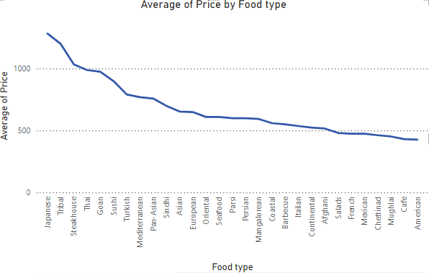
Cuisine Analysis
Findings
﻿Across all 81 Food type, Average of Delivery time ranged from 36.33 to 80.00.
Tribal had the highest Average of Delivery time at 80.00, followed by Bangladeshi and Singaporean. Haleem had the lowest Average of Delivery time at 36.33.
The expensive restaurants mostly provides continental food type like japanese, turkish, european etc

Slide 11
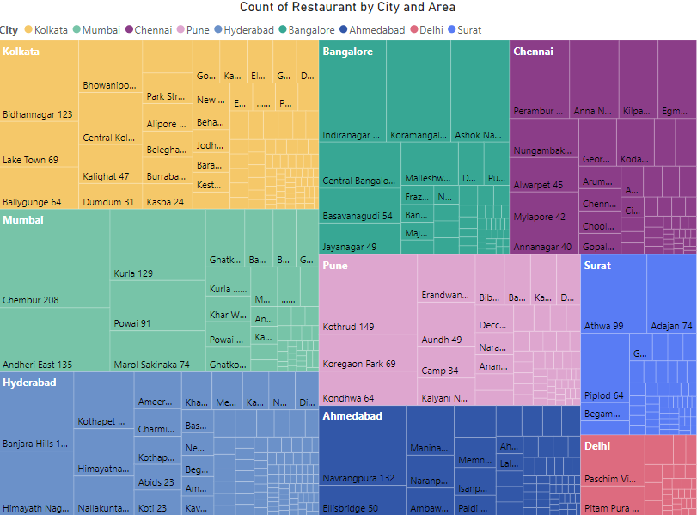
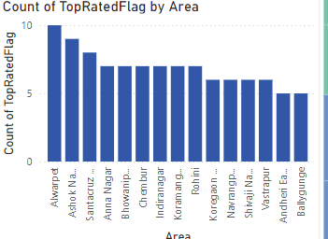
Area wise restaurant analysis
Findings
﻿The number of Restaurant was highest for Rohini at 257, followed by Chembur and Kothrud.
Alwarpet and ashok nagar has highest number of top rated restaurant
T. nagar and central kolkata has lowest number of top rated restaurants

Slide 12
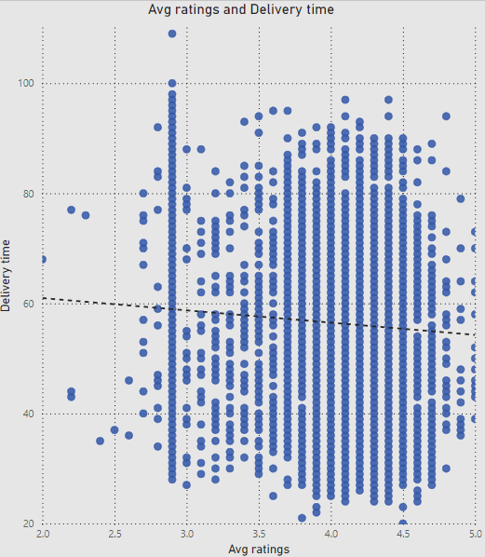
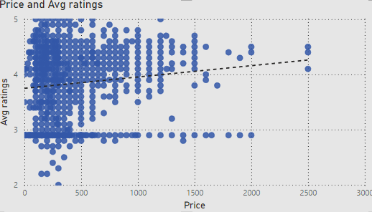
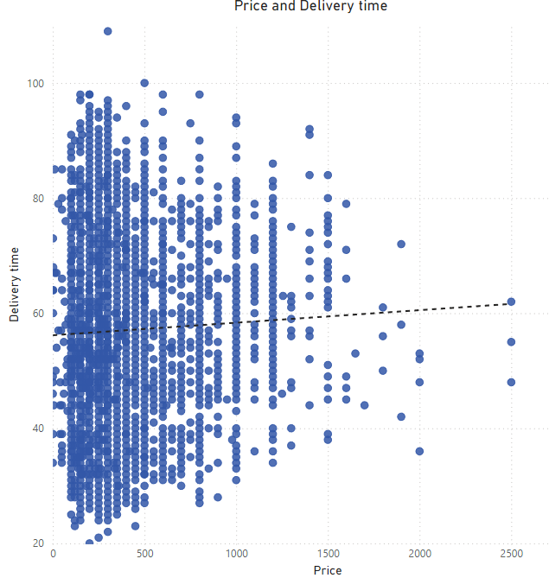
Correlation Analysis
Findings
In delivery time and avg rating analysis, the trend line shows a negative correlation, suggests that faster delivery times are associated with higher customer satisfaction and ratings
In price and avg rating analysis, the trend line shows a positive correlation, suggests that higher-priced restaurants tend to have higher average ratings.
In price and delivery time analysis, the trend line shows a positive correlation, suggests that higher-priced restaurants tend to have longer delivery times.

Slide 13
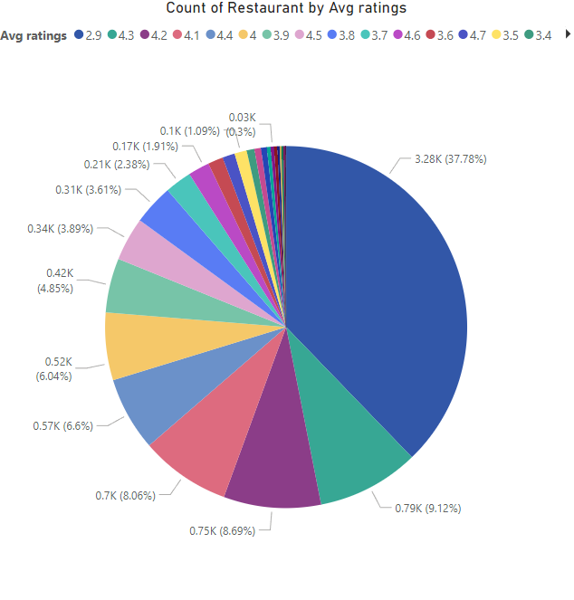
Correlation Analysis
Findings
In delivery time and avg rating analysis, the trend line shows a negative correlation, suggests that faster delivery times are associated with higher customer satisfaction and ratings
Count of Restaurant was highest for 2.90 rating at 3,279, followed by 4.30 and 4.20.

Slide 14
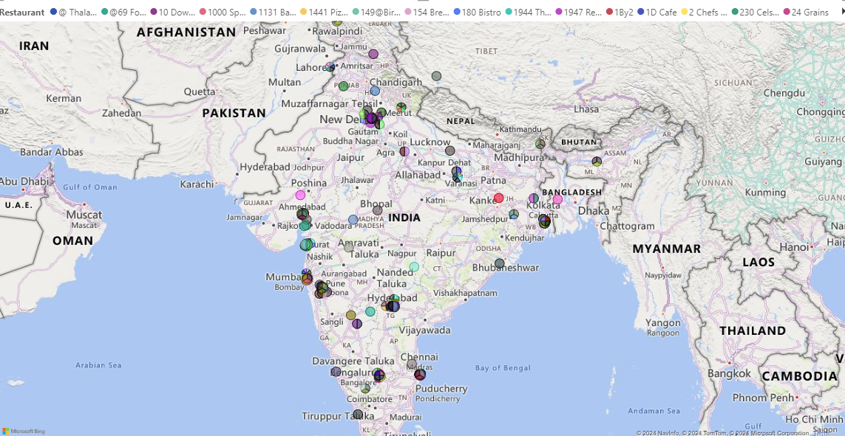
Geographical Mapping
Findings
Swiggy restaurants are mostly targeted in maharashtra.
West and north of india has fewer restaurants.

Slide 15
Business recommendations
Given that rohini has the highest number of restaurants, investing in this area could yield high returns due to the established demand. Consider opening new branches or introducing new restaurant concepts to the market.
Customize your menu to reflect the most popular food types in each city to cater to local tastes and increase customer satisfaction.
Given that 3.73 % of restaurants are top rated, Focus on improving the overall quality and consistency of food and service across all locations. Actively seek and act on customer feedback to identify areas for improvement.
Restaurants might consider adjusting their pricing strategy to align with the perceived value, ensuring that higher prices are justified by superior offerings.
Improving delivery efficiency could be a key area for restaurants to enhance their ratings. Implementing real-time tracking and better logistics could help reduce delivery times.
Evaluate cities with lower restaurant counts but growing populations or emerging economic opportunities for potential market entry.
Emphasize value propositions to attract customers across different price segments.
Use faster delivery times as a competitive advantage to enhance overall service quality.
Leverage online platforms and digital marketing strategies to reach a broader audience interested in continental cuisines.

Slide 16
Thank you

